Slide 1
Hand detection and Volume gesture control
(DIP)

Slide 2

Problem statement:
Volume gesture control is to develop a system that can recognize hand gestures and use them to control the volume of an audio device. The system should be able to recognize different hand gestures and the system should also be able to adjust the volume of the audio device based on the intensity of the gesture.

Slide 3
Objectives
Intuitive control: Offer natural, intuitive volume control using easy-to-understand gestures without physical buttons or
complete menu navigation.
Hands-free operation: Volume gesture control allows hands-free volume adjustment, benefiting users from occupied hands
or distance interactions.
Enhanced user experience: Volume gesture control improves user experience by enhancing interactive, engaging control of
Volume levels.
Accessibility: Volume gesture control enhances accessibility for disabled users by enabling gesture-based adjustment.
Customizability: Customize volume gesture control to cater to individual needs and preferences, allowing users
to personalize their experience.
Consistency and reliability: The system should aim to consistently recognize and respond to volume gestures accurately. It
should minimize false positives or misinterpretations, ensuring that users can rely on the gesture control for precise volume
adjustments.
Privacy and security: Volume gesture control must adhere to privacy and security standards, ensuring secure and trusted
Volume adjustment.

Slide 4
Motivation
The purpose of gesture volume control is to offer an alternate method of controlling a device's volume without having to physically contact with it. Input is recognized by this system using a high-resolution camera and hand gesture detection. A project that uses Python and OpenCV to illustrate implementation captures dynamic human hand motions and regulates loudness. A fascinating subject that allows for natural contact and lowers sensor costs is hand gesture recognition.
Devices like mouse, keyboards, and gaming consoles are necessary for traditional interactive techniques including mouse, keyboard, touch screen, and joysticks. The cognitive burden and attention required of users are reduced through hand gestures, which are more expressive, natural, and efficient than typing or tapping.

Slide 5
Literature Survey on Hand Gesture Recognition System
Hand gesture recognition systems are improving communication and interaction between humans and machines, particularly for deaf and dumb individuals. These systems utilize real-time continuous gesture recognition techniques, such as posture, position, orientation, motion, embedded systems, color maker, glove-based, vision-based, and depth-based approaches. These systems detect hand images, pre-process them, crop them for analysis, extract features, classify them, and convert them into speech. Hand gesture recognition systems provide human computer interaction and have been used in Sign Language Recognition and gesture-based control.

Slide 6
Real-Time HGR Using Surface Electromyography and Machine Learning
Human-Computer Interaction (HCI) has been developed to overcome communication barriers between humans and computers. HGR predicts the class and instant of execution of hand movements using surface electromyography (EMG) data. This systematic literature review analyzes real-time hand gesture recognition models using EMG data and machine learning. The review analyzed 65 primary studies using the Kitchen ham methodology, analyzing models, data acquisition, segmentation, preprocessing, feature extraction, classification, post processing, real-time processing, gesture types, and evaluation metrics. The review identified trends and gaps for future research in gesture recognition using EMG.

Slide 7
Hand Gesture Controlled using Open CV and Python
Gesture recognition is a powerful tool in artificial intelligence, enabling human-computer communication and enhanced user interaction. Python libraries like Open Computer Vision and cvzone2 help in capturing, image pre-processing, and detection, as well as mapped action pairs for specific tasks. Hand gestures are the most robust transmission mode for human-computer interaction, and this project uses them to input a web camera. The camera reads the image data and analyzes it to determine the type of gesture made by the user. The webcam detection process serves as a medium for computer and human interaction without words or external input devices. Using hand gestures as input makes it easy to perform commands, such as scrolling or pointing to specific tasks in a PowerPoint presentation.

Slide 8
Hand Gesture Recognition Algorithm Using SVM and HOG Model for Control of Robotic System
In this paper, we present the histogram of oriented gradient (HOG) and support vector
machines (SVM) combined gesture recognition technique. In addition, we also categorise
gestures using the CNN model. We approach and choose problem-controlling approaches to
use with the robotic system. The algorithm's objectives are to recognise movements quickly in
real-time, eliminate interference, and make it harder to capture accidental motions. In this
study, static gesture controls such as on, off, rising, and decreasing are employed.
Additionally, it makes use of motion gestures to change the volume and turn on the status
switch. Results indicate that the algorithm is up to 99% accurate and has an industrial
application-appropriate execution time of 70 milliseconds per frame.

Slide 9
Challenges
Gesture recognition accuracy: Accurate volume gesture recognition requires sophisticated
algorithms, robust techniques and addressing hand shapes and movements.
Environmental conditions: Environmental factors impact volume gesture control system
performance, affecting image capture and recognition accuracy.
User adaptation and learning curve: New volume gesture control requires user adaptation,
learning, and minimizing effort; intuitive, user-friendly system ensures comfort and satisfaction.
System responsiveness: Volume gesture control systems require responsiveness, real-time
feedback, low-latency, high-performance algorithms for seamless interaction.
Integration with existing interfaces: Integrating volume gesture control with existing interfaces is
challenging; design ensures compatibility across platforms and devices.

Slide 10
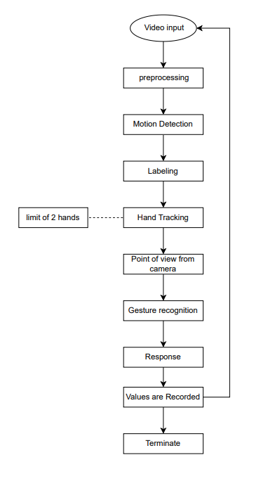
System Architecture of VGC

Slide 11
References
RESEARCH GATE, GOOGLE.
MEDIAPIPE, GOOGLE, Available: https://mediapipe-studio.webapps.google.com/demo/hand_landmarker
R. ALAMI "A methodological approach relating the classification of gesture to identification of human intent in the context of human-robot interaction”, 371- 377 2005.
H.A JALAB "Static hand Gesture recognition for human computer interaction”, 1-72012. 4) JC.MANRESARVARONAR. MASF.
PERALES” Hand tracking and gesture recognition for human-computer interaction", 2005.
Intel Corp, “OpenCV Wiki,” OpenCV Library [Online], Available: http://opencv.willowgarage.com/wiki .
W. T. Freeman and M. Roth, Orientation histograms for hand gesture recognition. International workshop on automatic face and gesture recognition. 1995, 12: 296- 301

Slide 12

Thanks!
Please, keep this slide as attribution

